Slide 1
Python Object Oriented Programming
Jesse Cowles
INdigital Telecom
Presented on:
November 12, 2013 at Meetup

Slide 2
Design
Why are we starting at design??
Always have a design!
In your head
Diagram on paper
Diagram in software, ex. Microsoft Visio
http://en.wikipedia.org/wiki/Unified_Modeling_Language
Various designs have various levels of detail
Choose the detail and design model by business requirements and functional requirements
Consider future requirements and reusability
In the design, identify:
The components/objects
The actions for each object
Some actions/messages are sent by the object, and others are received
The states of each object
If an object has multiple actions which must be performed in a certain order, then the object has more than one state. The current state determines which actions can be performed at the current time. The current state can change to a different state when an action is performed.
The data associated with each object
If an object has 2+ states, there must be a way to determine which state the object is currently in, which means that there must be some kind of data stored to indicate the current state
Other data

Slide 3

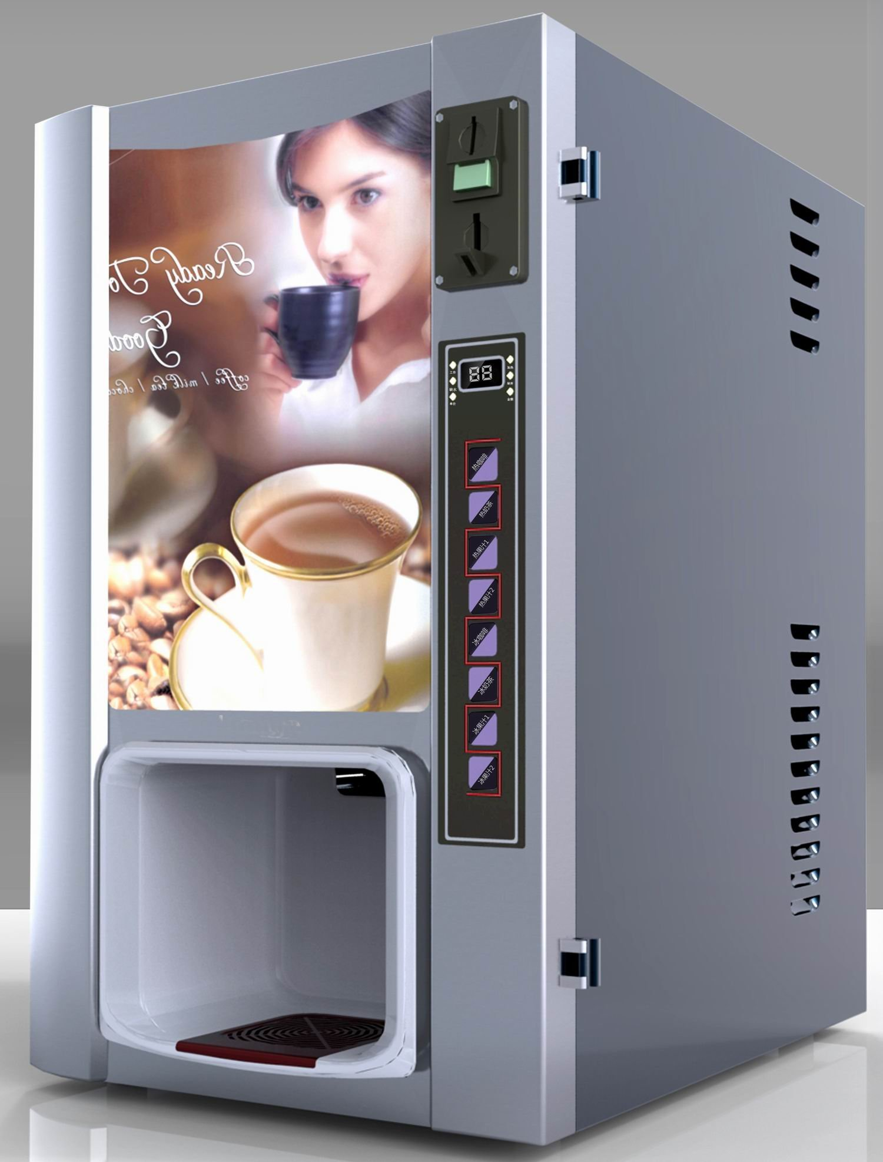
Simulate a coffee vending machine!
This is a coffee vending machine →

Slide 4
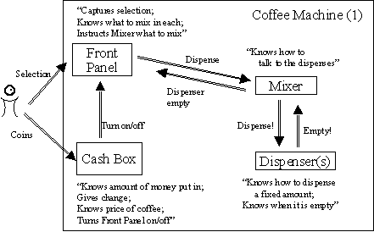
A Vending Machine Design
http://heim.ifi.uio.no/~mmo/generic/papers/coffee/Coffee-1.html

Slide 5
More Complete Vending Machine Design
The objects for this design are:
User
Coffee type selection panel
Cup size selection panel
Coin Box/Trap
Dispenser
User
States
The user's state is based on the current state of other objects.
Example: Is there a cup in the dispenser? If so, I'm ready to grab the cup.
Actions/Messages Received
Retrieves state from other vending machine objects
Actions/Messages Sent
Deposits coin
Presses buttons
Type of coffee
Cup size

Slide 6
A More Complete Vending Machine Design
Coffee type selection panel
States
Initial state: Buttons can be pushed after dispensing has completed
Buttons can't be pushed after a cup size has been selected
A coffee type is either selected or not selected
Actions/Messages Received
Receives button presses from user which determines coffee type based on which button is pressed
Cup size panel tells coffee type panel when a cup size has been selected, to disable coffee type buttons
Dispenser tells coffee type panel when it's done
Actions/Messages Sent
After a coffee type button is pressed, tell the cup size selection panel to enable its buttons
Data
Currently selected coffee type is stored
Button press enabled/disabled state

Slide 7
A More Complete Vending Machine Design
Cup size selection panel
States
Buttons can be pushed after selecting a coffee type
Buttons can't be pushed after the coffee has been paid for
Actions/Messages Received
Coffee type panel tells cup size panel when a button has been pressed
Receives button presses from user which determines cup size based on which button is pressed
Coin box retrieves price of cup size
Coin box tells cup size panel when the coffee has been fully paid for
Actions/Messages Sent
When a cup size button has been pressed:
Tell the coffee type panel to disable its buttons
Enable the coin box
Data
Currently selected cup size is stored
Button press enabled/disabled state
Price of each available cup size

Slide 8
A More Complete Vending Machine Design
Coin Box Trap
States
Enabled – Coins are caught by the trap, fall into the coin box, and the amount registers in the machine. Coin value is counted.
Disabled – Coins fall through the coin trap and can be picked up by the user again. Coin value is not counted.
Actions/Messages Received
Receives weight of each coin dropped from internal trap. (Internal trap could be treated as a separate object, but isn't in this example.)
When total cost has been paid, tell dispenser to dispense
Actions/Messages Sent
When total cost has been paid:
Tell cup size panel to disable its buttons
Instruct mixer to dispense liquid
Data
Total amount of money inserted so far
Conversion data – coin weight measures to cents

Slide 9
A More Complete Vending Machine Design
Dispenser
States
Dispensing or not dispensing liquid
Actions/Messages Received
At start of dispensing, retrieve coffee type and cup size
Actions/Messages Sent
When done dispensing, enable the coffee type panel
Data
Whether currently dispensing or not dispensing

Slide 10
Let's Implement the Coffee Type Selection Panel
Each object becomes a class
Each action/message sent is implemented by making the sender class call a method which is implemented in the receiver class
Think about the names for your objects, methods, and variables carefully. Using precise names will help others understand your code!

Slide 11
Let's Implement the Coffee Type Selection Panel
Review the Design:
States
Initial state: Buttons can be pushed after dispensing has completed
Buttons can't be pushed after a cup size has been selected
A coffee type is either selected or not selected
Actions/Messages Received
Receives button presses from user which determines coffee type based on which button is pressed (notifyButtonPress)
Cup size panel tells coffee type panel when a cup size has been selected, to disable coffee type buttons (disableButtons)
Dispenser tells coffee type panel when it's done, so coffee type panel can enable its buttons (enableButtons)
Actions/Messages Sent
After a coffee type button is pressed, tell the cup size selection panel to enable its buttons (enableButtons)
Data
Currently selected coffee type is stored (currentCoffeeType)
Button press enabled/disabled state (canPress)

Slide 12
Coffee Type Selection Panel Implementation in Python
class CoffeeTypePanel(object):
"""A panel allowing the user to choose a type of coffee.""" # docstring
_idToType = ["regular", "decaf"] # class variable
# we'll be sending a message to the cupSizePanel later, so we need a reference to it
def __init__(self, cupSizePanel):
self._currentCoffeeType = None # private instance variable
self.cupSizePanel = cupSizePanel # public instance variable
self.enableButtons()
def enableButtons(self): # called by Dispenser instance
self._canPress = True
def disableButtons(self): # called by CupSizePanel instance
self._canPress = False
def notifyButtonPress(self, buttonID):
assert self._canPress
self._currentCoffeeType = self._idToType[buttonID]
self.cupSizePanel.enableButtons()
def getCurrentType(self):
return self._currentCoffeeType

Slide 13
What is self?
Similar to this keyword pointer in C++
class VendingMachine
{
public:
void insertMoney(float amount);
private:
float insertedMoney;
};
<snip>
void VendingMachine::insertMoney (float amount) {
this->insertedMoney += amount;
}
Similar to this keyword in Java
public class VendingMachine {
public int insertedMoney = 0;
<snip>
public void insertMoney(float amount) {
this.insertedMoney += cents;
}
}

Slide 14
What is self?
Unlike Java and C++:
self is not a keyword
self must be passed in explicitly, as a normal parameter

Slide 15
The End
Learn more about Python at:
http://docs.python.org/3.3/tutorial/

Slide 16
What is object?
Everything is an object in python – any number, any class, any instance of a class, etc.
For a class, you can choose whether that class inherits any behavior from another class or not. The object class has very basic behavior and is included in the Python language.
More inheritance at a future meetup?

